Slide 1






Slide 2

School of Engineering Technology and Applied Science
S2P: SUSTAINABLE SERVICE PRICING IN CLOUD ECOSYSTEMS
Reza Dibaj

Slide 3

Outline
Introduction
Main pricing model challenges
Influential Factors on Cloud Pricing
An Elephant in the Light: A Comprehensive Pricing Factors Taxonomy
Contribution One: Sustainable Fair Pricing Mechanism
Related Work for Contribution One
My Methodology for Contribution One
Contribution Two: Dynamic Resource Allocation (DRA)
Introduction to Contribution Two
My Methodology for Contribution Two
References

Slide 4
Outline
Introduction
Main pricing model challenges
Influential Factors on Cloud Pricing
An Elephant in the Light: A Comprehensive Pricing Factors Taxonomy
Contribution One: Sustainable Fair Pricing Mechanism
Related Work for Contribution One
My Methodology for Contribution One
Contribution Two: Dynamic Resource Allocation (DRA)
Introduction to Contribution Two
My Methodology for Contribution Two
References

Slide 5
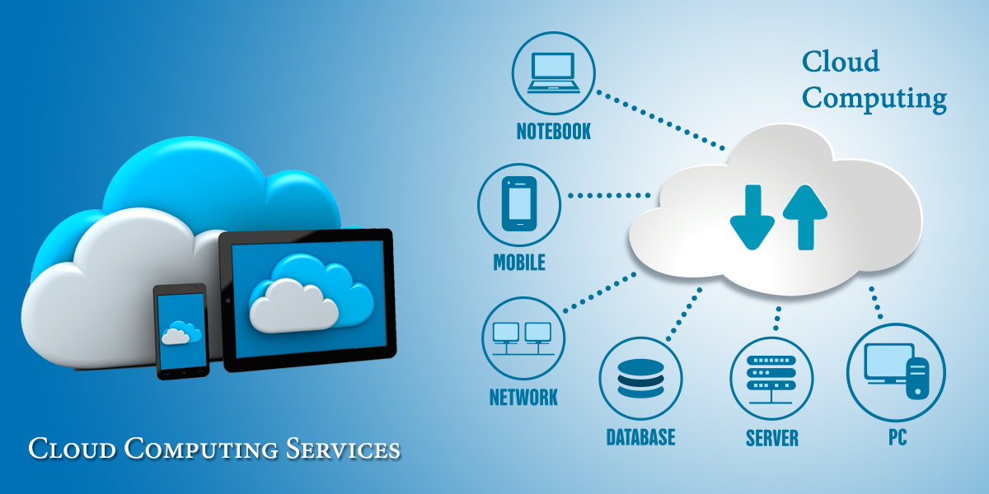
Introduction
National Institute of Standards and Technology (NIST): “cloud computing is a model for enabling ubiquitous, convenient, on-demand network access to a shared pool of configurable computing resources (e.g. networks, servers, storage, applications, and services) that can be rapidly provisioned and released with minimal management effort or service provider interaction.”
Notes:
Ref: [03], [08]
Lower cost, easier resource management, and less installation requirement are some of the benefits of using cloud ecosystems.
One of Google's white papers, task centric, user centric, intelligence, powerfulness, and programmability are five main features of cloud computing.
Like any other service utilities, (water, electricity, gas, and telephony) cloud computing services have their own advantages as well as challenges.

Slide 6
Introduction
Energy efficient and management techniques:
Energy-aware cloud architecture
Reduce energy consumption
Energy-efficient Cloud Ecosystem
Appropriate resource allocation
Business Model
Decrease electricity usage
Appropriate service pricing
Reduce the total service costs
Notes:
Ref: [07], [10]
Energy-aware cloud architecture:
Load balancing and scaling algorithms → Load on a subset of servers and switch the rest of them off (or to the low energy consumption mood, such as hibernate)
→Servers work at optimal or near optimal energy level (observing SLA)
Optimal energy level =>When the performance per Watt is maximized
→Balance between computational efficiency and SLA violation (maximizing computational efficiency and minimizing SLA violation)
Reducing energy causes the reduction in electricity usage and as electricity is one of the most dynamic parameters, it is very important to utilize the offered services with energy-based pricing mechanism.
Reduce the total service costs =>then the customer should pay less => Bring higher revenue to cloud service providers

Slide 7
Introduction
Energy efficient and management techniques:
More attention
Reducing total power consumption
Cloud Energy Research
Impact customers
Task behavior
Less attention
Required performance
Pricing approach
Cost/Price
Encourages users efficient service usage
Customers’ behavior
Notes:
Ref: [10], [11], [12], [13], [14]
Most research => Reducing the total power consumption, e.g. VM consolidation
Less attention to:
Task behavior
Required performance
Cost/Price
Role of customer behaviors
Service providers try to lower their costs by applying newer technologies.
Service Level Agreement (SLA) is a contract between cloud providers and cloud service users. [Contains charging customers and the quality of offered service]
Pricing approach + SLA => Customers’ loyalty + Cloud providers’ revenue
Many factors should be considered in finalizing service prices, such as:
Competition in the market
Maintenance costs
Lease period
QoS
Idle resources
Electricity costs
& …

Slide 8
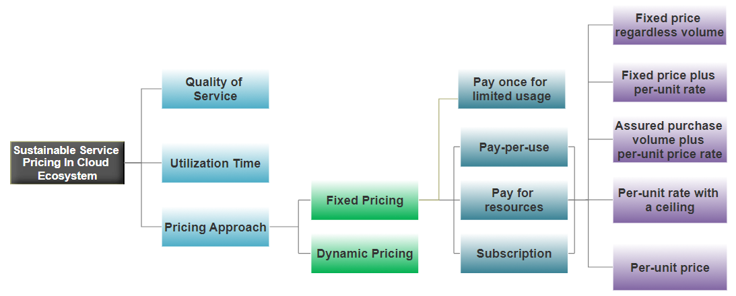



Introduction
General Pricing Models in Cloud Computing Ecosystem:
Straight-forward
Easy to understand
Lack of fairness
Transparency
Complexity
Notes:
Ref: [11], [21]
Fixed or static pricing VS Dynamic or variable pricing
Fixed pricing : charging price should remain constant during the service time
Dynamic pricing: The price should change in a dynamic way based on a variety of factors, including the usage amount, traffic, electricity cost, technical maintenance fees, and et cetera
Why not market dependent as a separated group?
Why not list price model as a separated group?
tiered-pricing classifies each service into a specific quality level, but it is still a type of Pay-per-use pricing
Summary: The problem of current pricing approach is they more represents the market tricks to provide enough incentives to attract more customers.
They do not represent a relationship between pricing factors and final offered prices and how the pricing system can cover the initial costs and bring benefits.

Slide 9
Introduction
How to Improve Current Pricing Approaches:
Good estimation of users
Solving these problems
Good estimation of used resources
Pay-per-use fixed pricing
Not clear for the users
Solving these problems
Bias towards the providers
How to Improve Current Pricing Approaches
Pay for resources
Subscription
Notes:
If we a good estimation of number of subscribed users and ad-hoc users, we can divide the fixed costs among the customers in a fairer and more accountable way.
The drawback of subscribed users: No guarantee to keep the registered customers => No necessary accurate resource usage
Finding accurate enough resource demands predictions without firm dependency to subscribed customers is one of the challenges.

Slide 10
Outline
Introduction
Main pricing model challenges
Influential Factors on Cloud Pricing
An Elephant in the Light: A Comprehensive Pricing Factors Taxonomy
Contribution One: Sustainable Fair Pricing Mechanism
Related Work for Contribution One
My Methodology for Contribution One
Contribution Two: Dynamic Resource Allocation (DRA)
Introduction to Contribution Two
My Methodology for Contribution Two
References

Slide 11

Main pricing model challenges
Describing the main pricing model challenges [31]:
Obscurity of the billing process
Main pricing model challenges
Gap between resource usage and billing
Reduces the computational complexity
Aggregate different events into a single line of code
Reduces the accuracy
Bias towards the providers
Notes:
Ref: [31]
1: The billing process is not clear enough as it happens within the cloud infrastructure
One of the targets of the current thesis is clarifying the pricing processes to make the billing mechanism as transparent as possible.
For transparency we need:
→ a comprehensive taxonomy that the current thesis tries to offer one
→ a flexible classification

Slide 12
Outline
Introduction
Main pricing model challenges
Influential Factors on Cloud Pricing
An Elephant in the Light: A Comprehensive Pricing Factors Taxonomy
Contribution One: Sustainable Fair Pricing Mechanism
Related Work for Contribution One
My Methodology for Contribution One
Contribution Two: Dynamic Resource Allocation (DRA)
Introduction to Contribution Two
My Methodology for Contribution Two
References

Slide 13

Influential Factors on Cloud Pricing
Defining influential factors on cloud pricing [32]:
Initial costs
Lease period
Quality of Service
Age of resources
Cost of maintenance
Which items are static and which items are dynamic?
How should we treat static and dynamic factors in cloud service calculations?
How about other important factors, such as greenness of the energy resources, electricity costs, fairness, competition, market demands and et cetera.
Notes:
Ref: [32]

Slide 14
Outline
Introduction
Main pricing model challenges
Influential Factors on Cloud Pricing
An Elephant in the Light: A Comprehensive Pricing Factors Taxonomy
Contribution One: Sustainable Fair Pricing Mechanism
Related Work for Contribution One
My Methodology for Contribution One
Contribution Two: Dynamic Resource Allocation (DRA)
Introduction to Contribution Two
My Methodology for Contribution Two
References

Slide 15

An Elephant in the Dark
Some Hindus have an elephant to show.
No one here has ever seen an elephant.
They bring it at night to a dark room.
One by one, we go in the dark and come out
Saying how we experience the animal.
One of us happens to touch the trunk.
A water-pipe kind of creature.
Another, the ear. A very strong, always moving
Back and forth, fan-animal. Another, the leg.
I find it still, like a column on a temple.
Another touches the curved back.
A leathery throne. Another the cleverest,
Feels the tusk. A rounded sword made of porcelain.
He is proud of his description.
Each of us touches one place
And understands the whole that way.
The palm and the fingers feeling in the dark
Are how the senses explore the reality of the elephant.
If each of us held a candle there,
And if we went in together, we could see it.
-Rumi

Slide 16

An Elephant in the Light

Slide 17
An Elephant in the Light: A Comprehensive Pricing Factors Taxonomy
Pricing approach:
Pricing approach
Price calculation for offered services
Unbiased
Service price definition
Rational
Fair pricing definition
Transparency
Both satisfied
Notes:
Ref: [11], [15], [17], [18], [19]
Service Pricing Definition: The process of service measurement and the exchange of finance for the delivered services to end users is called pricing.
Any organization for its success needs fair pricing mechanism.
Fairness is a subjective concept.
Unbiased
Rational
Transparency
Both satisfied
Current market: strongly biased towards providers. => we need to know and consider customers' point of view
Customers => need lower prices and higher qualities (natural tendency)
Providers => use newer technologies to lower their prices and increase their revenue
VM migrations
Server consolidations
Energy and traffic management
Analysis
The rule of supply and demand:
Demand: the amount of service or good which is needed in the market
Supply: the amount of service or good that can be produced in the market
For fair pricing it is necessary to have a good understanding of the factors that engage in cloud pricing mechanism
For fair pricing we need a Dynamic Mechanism that can accept any parameter that was not considered before.
Before Formulating, an appropriate taxonomy of pricing elements is necessary.

Slide 18
An Elephant in the Light: A Comprehensive Pricing Factors Taxonomy
Cooling Infrastructure
Building and site costs
Water pipes
Installation & infrastructure
Cabling
Static Factors
Fire protection system
Datacenter security
Hardware & net. components
Computer Resources
Software components

Slide 19
An Elephant in the Light
Annual Taxes
Annual prices
Annual building maint. fee
Annual infra. maint. fee
Lease period
Service availability
App. architecture
Service provider's integrity
Hardware
Scalability
Network
Dynamic Factors
QoS
Security level
Confidentiality
Privacy
Data integrity
Performance evaluation
Control & Audit
SLA violation penalty
Hardware failure
System failure
Network failure
Software failure
Notes:
Scalability → Application architecture (Ready for bursty requests)
→ Hardware (Servers)
→ Network
Performance Evaluation Challenges: → Not standard terminology
→ Correct but imprecise analysis
→ Incorrect analysis
Point: System failure is different from service availability
Point: Hardware failure has a direct relationship with the age of resources
Point: @Hardware failures → Age of resources is quite difficult as age does not impact equally on all components and brands.
Point: Software failures such as →Viruses
→Malware
→O.S. Failure
→Slowness due to lack of H/W resources

Slide 20
Full-time
An Elephant in the Light
Salary of employees
Part-time
Scale up
Technical maintenance
Outsourcing tech. problems
Improvement
Computer Resources
Hardware & net. components
Replacement
Scale out
Software components
Repairment
Green source of energy
Energy source classification
Fossil fuel & nuclear
Electricity cost
Renewable energy
Customer classification
Dynamic Factors
Resource idle time
Process type
Time-flexible process
Geographical location
Greenness of the sources
Time-sensitive process
Server idle time
Fairness
Virtual Machine idle time
Competitors
Available service locations
Market demand
Service calc. based on dist.
Notes:
Ref: [34]
Technical maintenance → Fixing H/W & S/W failure
→ Keep services up & running
Computer resources → Hardware and network components → Moore's law says the increase in [performance per dollar & serial interface speed for communications]
Green Source of Energy: Renewable & much less environmental impacts
Google [100% by 2017]
Microsoft [60% by 2020]
Amazon [50% by 2017]
Rackspace [50% by 2016]
Energy source classification: → Fossil fuel & nuclear electric power
→ Renewable energy
Resource idle time: → Virtual Machine idle time (VM Consolidation)
→ Server idle times

Slide 21
Outline
Introduction
Other theoretical improvement suggestions for current pricing approaches
Main pricing model challenges
Influential Factors on Cloud Pricing
An Elephant in the Light: A Comprehensive Pricing Factors Taxonomy
Contribution One: Sustainable Fair Pricing Mechanism
Related Work for Contribution One
My Methodology for Contribution One
Contribution Two: Dynamic Resource Allocation (DRA)
Introduction to Contribution Two
My Methodology for Contribution Two
References

Slide 22
Contribution One:
Sustainable Fair Pricing Mechanism

Slide 23
Outline
Introduction
Other theoretical improvement suggestions for current pricing approaches
Main pricing model challenges
Influential Factors on Cloud Pricing
An Elephant in the Light: A Comprehensive Pricing Factors Taxonomy
Contribution One: Sustainable Fair Pricing Mechanism
Related Work for Contribution One
My Methodology for Contribution One
Contribution Two: Dynamic Resource Allocation (DRA)
Introduction to Contribution Two
My Methodology for Contribution Two
References

Slide 24
Related Work for Contribution One
For Static
Autonomic metered pricing for a utility computing service → High-demand and Low-demand
Using formulas
Comparing Cloud Service prices vs in-home service prices
Correlation between the cloud service level and the offered price
Revenue optimization and Price discrimination → User classification and Resource usage
Pricing Model and Simulation of Public Cloud Services → Bandwidth and Network congestion
For Dynamic
Spot Instance
Notes:
[36]
No configuration suggestion for customers → Customers are responsible for their resource usage
Pricing models for on-demand computing [38]:
This study has suggested an optimal pricing model for on-demand computing services considering four important components:
The cost of providing the same service in-house
The business value of the current infrastructure
The cloud provider's infrastructure scale for the on-demand computing services
Variable costs of on-demand computing

Slide 25

Related Work for Contribution One
Why we need something better?
Most of the studies concentrated on one or a few features.
A flexible dynamic pricing mechanism will be declared in the current thesis.
A wide range of parameters
Sustainable Fair Pricing Mechanism: A Flexible Dynamic Pricing Model
Flexible and open to new parameters

Slide 26
Outline
Introduction
Other theoretical improvement suggestions for current pricing approaches
Main pricing model challenges
Influential Factors on Cloud Pricing
An Elephant in the Light: A Comprehensive Pricing Factors Taxonomy
Contribution One: Sustainable Fair Pricing Mechanism
Related Work for Contribution One
My Methodology for Contribution One
Contribution Two: Dynamic Resource Allocation (DRA)
Introduction to Contribution Two
My Methodology for Contribution Two
References

Slide 27
My Methodology for Contribution One
Customers
Pay for what they have used or reserved
Increasing computational complexity
Fairer pricing mechanism
Using Dynamic Pricing Mechanism
Providers
Increasing response time
Clarity of the process
Notes:
Fairer pricing mechanism + Clarity of the process → Provides a higher revenue

Slide 28
My Methodology for Contribution One
Pricing and revenue optimization [42]:
Maximizing Cloud Providers Revenue
The system experiences variable, but predictable demands
Dynamic Pricing mechanism is mandatory
Prerequisites for Dynamic Pricing Mechanism
Its capacity for providing services is fixed
Resources are wasted if not used
Service providers are able to regulate the prices
Notes:
Ref: [42]
All the following items can be achieved in cloud services:
The system experiences variable, but predictable demands
Its capacity for providing services is fixed
Resources are wasted if not used
Service providers are able to regulate the prices
All the above mentioned factors are available for cloud service providers.
So the Dynamic Pricing Mechanism is possible for cloud service providers.

Slide 29
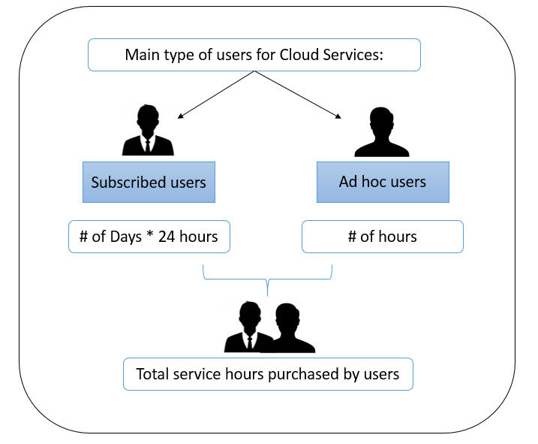
My Methodology for Contribution One
Step 1: Users Classification
Lower service prices for all users
Higher benefit in shorter time for providers
Better resource estimation for providers
Affordable service price for limited usage
Notes:
Subscribed users: for determined amount of time
Ad hoc users: for fulfilling limited services or tasks

Slide 30
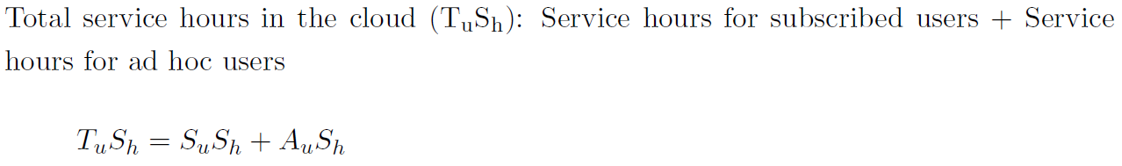
My Methodology for Contribution One
Step 1: Users Classification
Calculating service hours for subscribed and ad hoc users:

Slide 31
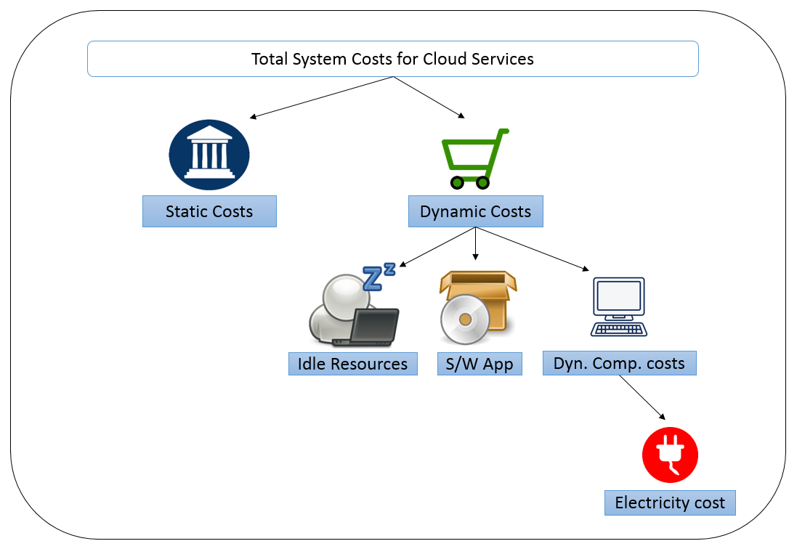
My Methodology for Contribution One
How to calculate total costs:

Slide 32
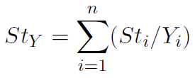
My Methodology for Contribution One
Step 2: Calculating Static Costs
Cost of static factors
Static Costs
Number of years to amortize the cost
The number of years that expected that static factor to be amortized
The static item number i
The summation of all static factors that should be amortized in a year

Slide 33


My Methodology for Contribution One
Step 3: Calculating Dynamic Costs (Part I: Calculating idle resources costs)
CPU, RAM, HDD, …
Quite sophisticated
Idle Resources
Virtual Machine
The most appropriate
Servers
Course granularity
Notes:
Idle resources are inevitable part of cloud ecosystem.
If we try to calculate the idle time for each hardware component, such as CPU, RAM and so on, it would be quite sophisticated to keep track and calculate all idle hardware components separately.
If we consider an entire server as a unit to be considered for the idle cases, it would be very rough course granularity.
Moreover, the normal tendency is to shut down the idle servers, and it cannot be considered as idle resource costs, the way that we consider other components.
With all aforementioned facts, the best unit to choose is virtual machines, but the problem is not all VMs have the same configuration.
The remedy for this challenge is to define a bare minimum VM configuration as a unit to deal with and consider any VM as a coefficient of the bare minimum VM unit.

Slide 34

My Methodology for Contribution One
Step 3: Calculating Dynamic Costs (Part I: Calculating idle resources costs)
The cost of the total amount of idle resources (VMs) could be calculated as follows:
total cost of idle resources
the cost of total number of hours that basic VMs are idle in a year

Slide 35
My Methodology for Contribution One
Step 3: Calculating Dynamic Costs (Part II: Calculating software application costs)
If a user uses a software 365 days * 24 hours
We should ask for 10% of the original price for a whole year

Slide 36
My Methodology for Contribution One
Step 3: Calculating Dynamic Costs (Part III: Calculating dynamic computing costs)
Processing factor = P
Computing Factors
Main Memory (RAM) factor = R
Resource utilization assessment factors
Storage (Data) factor = D
Network factor = N
Notes:
Ref: [44]
Processing factor = P
Main Memory (RAM) factor = R
Storage (Data) factor = D
Network factor = N
These are the factors that are mostly used in the utilization assessments.

Slide 37

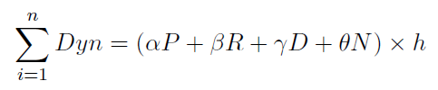

My Methodology for Contribution One
Step 3: Calculating Dynamic Costs (Part III: Calculating dynamic computing costs)
The total dynamic costs, including the electricity in one year
# of hours
Measurable

Slide 38
My Methodology for Contribution One
Step 3: Calculating Dynamic Costs (Part IIII: Including electricity costs)
For this step we should calculate the ratio of electricity consumption over the total dynamic costs.
Notes:
For the sake of simplicity we assume that we only have two electricity price category: high price and low price.
Once we calculate the total electricity cost, as if we only paid the high price.

Slide 39
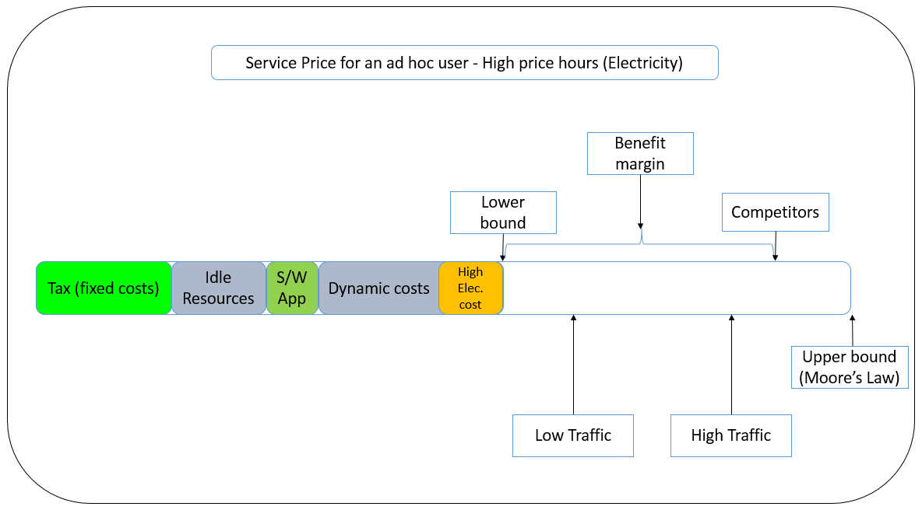
My Methodology for Contribution One
Summarizing all the steps: (Figure #01)

Slide 40
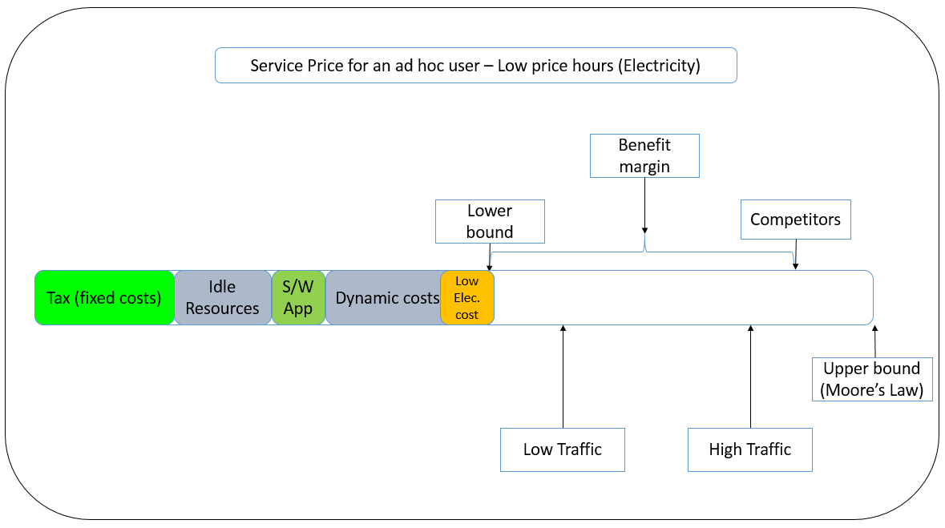
My Methodology for Contribution One
Summarizing all the steps: (Figure #02)

Slide 41
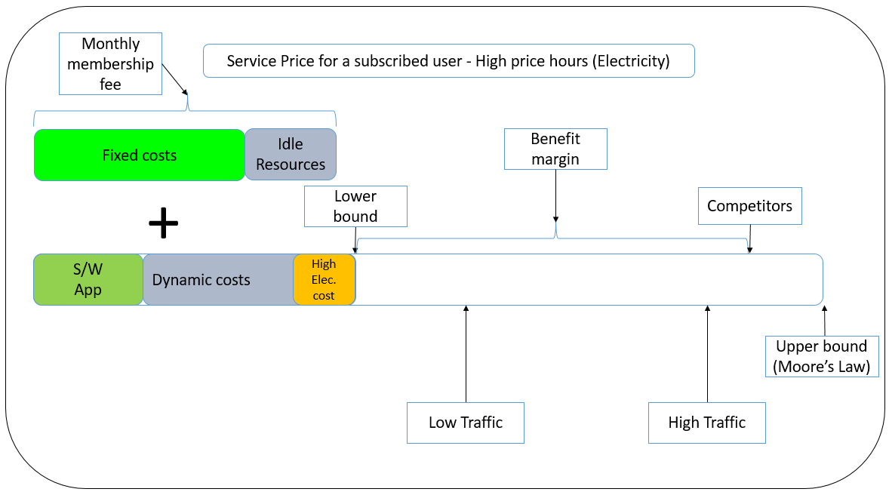
My Methodology for Contribution One
Summarizing all the steps: (Figure #03)

Slide 42
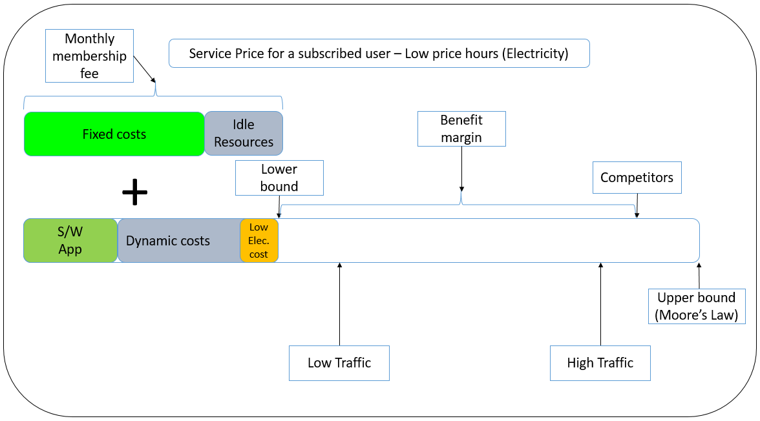
My Methodology for Contribution One
Summarizing all the steps: (Figure #04)

Slide 43
Outline
Introduction
Other theoretical improvement suggestions for current pricing approaches
Main pricing model challenges
Influential Factors on Cloud Pricing
An Elephant in the Light: A Comprehensive Pricing Factors Taxonomy
Contribution One: Sustainable Fair Pricing Mechanism
Related Work for Contribution One
My Methodology for Contribution One
Contribution Two: Dynamic Resource Allocation (DRA)
Introduction to Contribution Two
My Methodology for Contribution Two
References

Slide 44
Contribution Two:
Dynamic Resource Allocation (DRA)

Slide 45
Outline
Introduction
Other theoretical improvement suggestions for current pricing approaches
Main pricing model challenges
Influential Factors on Cloud Pricing
An Elephant in the Light: A Comprehensive Pricing Factors Taxonomy
Contribution One: Sustainable Fair Pricing Mechanism
Related Work for Contribution One
My Methodology for Contribution One
Contribution Two: Dynamic Resource Allocation (DRA)
Introduction to Contribution Two
My Methodology for Contribution Two
References

Slide 46
Introduction to Contribution Two
Why do we need to change configuration?
Energy efficiency
Improving resource utilization
Changing Resource Allocation
Applications’ optimization
Cost reduction
Notes:
Ref: [44]

Slide 47
Introduction to Contribution Two
Why do we need to change configuration?
Current Configuration
Y
>Actual need
N
Pay for unneeded resources
Decrease the performance
Pay more for the electricity
Energy wasting

Slide 48
Introduction to Contribution Two
How we initially configure our systems?
Using the history if available
1
Changing Resource Allocation
Rely on similar requests
2
If none of the above
3
Modify the suggested configuration dynamically
Suggesting minimum configuration as the initial
Close to what happens now in Cloud Ecosystems

Slide 49
Outline
Introduction
Other theoretical improvement suggestions for current pricing approaches
Main pricing model challenges
Influential Factors on Cloud Pricing
An Elephant in the Light: A Comprehensive Pricing Factors Taxonomy
Contribution One: Sustainable Fair Pricing Mechanism
Related Work for Contribution One
My Methodology for Contribution One
Contribution Two: Dynamic Resource Allocation (DRA)
Introduction to Contribution Two
My Methodology for Contribution Two
References

Slide 50
My Methodology for Contribution Two
The methodology for the current thesis
Current Thesis Methodology
Using the collected data to evaluate the cloud service performance
To tune the configuration automatically and dynamically

Slide 51
My Methodology for Contribution Two
Any system that needs to adjust itself has to have a strategy.
In this part of thesis contribution, we use two different methods:
MAPE-K
Amazon Lambda

Slide 52
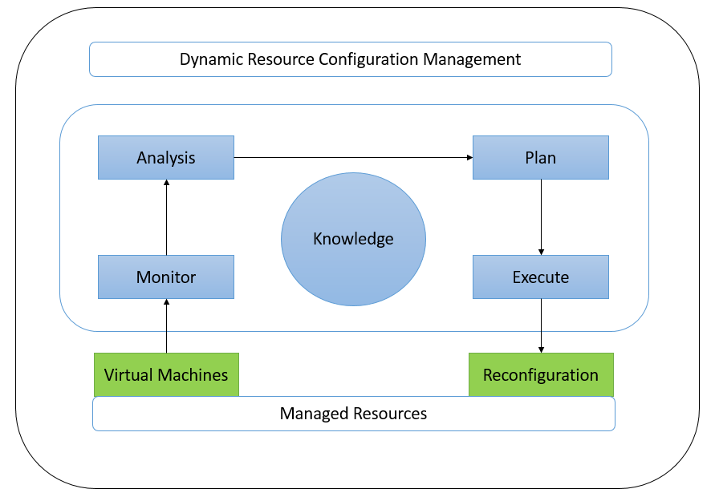
My Methodology for Contribution Two
MAPE-K from IBM
Notes:
Ref: [48]

Slide 53
My Methodology for Contribution Two
If the configuration needs to consider both historical data as well as the recent changes, normally two window frames needed to be considered:
Long-term window frames
Evaluating the System
Two window frames
Short-term window frames

Slide 54
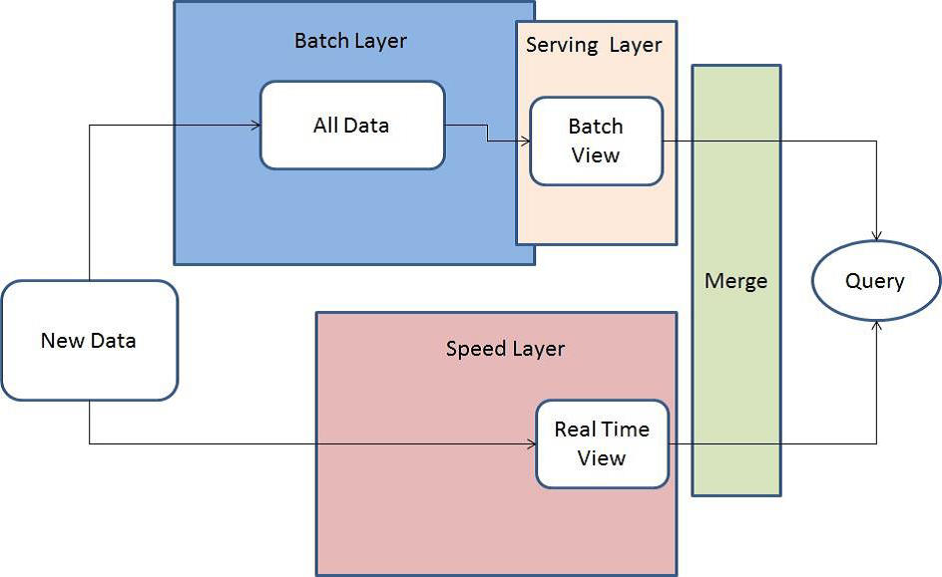
My Methodology for Contribution Two
How Amazon Lambda’s solution improves pricing approaches?
Amazon Lambda is a software design pattern that responses to online and batch processes in a single framework [49].
Notes:
Ref: [49]

Slide 55
My Methodology for Contribution Two
How to apply Amazon Lambda’s architecture?
History of the configuration or performance
Batch-layer segment
How to Apply Amazon Lambda
Combining these two layers can happen in the merge segment
Recent changes
Speed-layer segment
Small if changes are Big
The window size
Big if changes are Small
Notes:
Ref: [49]

Slide 56
Outline
Introduction
Other theoretical improvement suggestions for current pricing approaches
Main pricing model challenges
Influential Factors on Cloud Pricing
An Elephant in the Light: A Comprehensive Pricing Factors Taxonomy
Contribution One: Sustainable Fair Pricing Mechanism
Related Work for Contribution One
My Methodology for Contribution One
Contribution Two: Dynamic Resource Allocation (DRA)
Introduction to Contribution Two
Related Work for Contribution Two
My Methodology for Contribution Two
References

Slide 57
References
[01] Electric Meter. (2017, November 23). Retrieved January 08, 2018, from http://ethw.org/Electric_Meter
[02] Electricity meter. (2017, December 28). Retrieved January 08, 2018, from https://en.wikipedia.org/wiki/Electricity_meter
[03] G. Swenson. Final Version of NIST Cloud Computing Definition
Published. https://www.nist.gov/news-events/news/2011/10/
final-version-nist-cloud-computing-definition-published, Oct 2011. Accessed: 2017-11-23.
[04] M. Armbrust, A. Fox, R. Grith, A. Joseph, R. Katz, A. Konwinski, G. Lee, D. Patterson, A. Rabkin, I. Stoica, et al. Above the clouds: A berkeley view of cloud computing. Technical report, Technical Report UCB/EECS-2009-28, EECS Department, University of California, Berkeley, 2009.
[05] M. Kiran, P. Murphy, I. Monga, J. Dugan, and S. S. Baveja. Lambda architecture for cost-effective batch and speed big data processing. In IEEE International Conference on Big Data (Big Data), 2015, page 27852792. IEEE, IEEE, 2015.
[06] M. D. Dikaiakos, D. Katsaros, P. Mehra, G. Pallis, and A. Vakali. Cloud computing: Distributed internet computing for IT and scientific research. IEEE Internet computing, 13(5), 2009.
[07] A. Beloglazov. Energy-ecient management of virtual machines in data centers for cloud computing. PhD thesis, University of Melbourne, Department of Computing and Information Systems, 2013.
[08] R. Buyya, C. S. Yeo, S. Venugopal, J. Broberg, and I. Brandic. Cloud computing and emerging IT platforms: Vision, hype, and reality for delivering computing as the 5th utility. Future Generation Computer Systems, 25(6):599616, Jun 2009.
[09] Barr Follow, J. (2011, April 22). Introduction to Amazon Web Services. Retrieved January 10, 2018, from https://www.slideshare.net/AmazonWebServices/introduction-to-amazon-web-services-7708257
[10] L. Shari Energy-aware Service Provisioning in P2P-assisted Cloud Ecosystems. PhD thesis, Universitat Politecnica de Catalunya, 2016.

Slide 58
References
[11] M. Al-Roomi, S. Al-Ebrahim, S. Buqrais, and I. Ahmad. Cloud Computing Pricing Models: A Survey. International Journal of Grid and Distributed Computing, 6(5):93106, Oct 2013.
[12] S. Dutta, M. J. Zbaracki, and M. Bergen. Pricing process as a capability: A resource-based perspective. Strategic management journal, 24(7):615-630, Jul 2003.
[13] A. Hameed, A. Khoshkbarforoushha, R. Ranjan, P. P. Jayaraman, J. Kolodziej, P. Balaji, S. Zeadally, Q. M. Malluhi, N. Tziritas, A. Vishnu, and et al. A survey and taxonomy on energy ecient resource allocation techniques for cloud computing systems. Springer-Computing, 98(7):751774, Jul 2016.
[14] E. Iveroth, A. Westelius, C.-J. Petri, N.-G. Olve, M. Coster, and F. Nilsson. How to differentiate by price: Proposal for a ve-dimensional model. European Management Journal, 31(2):109123, Apr 2013.
[15] C. Weinhardt, A. Anandasivam, B. Blau, N. Borissov, T. Meinl, W. Michalk, and J. Stoer. Cloud Computing A Classication, Business Models, and Research Directions. Business & Information Systems Engineering, 1(5):391399, Oct 2009.
[16] L. E. Bolton, L. Warlop, and J. W. Alba. Consumer perceptions of price (un)fairness. Journal of consumer research, 29(4):474-491, 2003.
[17] Fair Value Definition from Financial Times-Lexicon. http://lexicon.ft.com/Term?term=fair-value. Accessed: 2017-11-25.
[18] M. Rouse. Fair and reasonable price. http://searchitchannel.techtarget. com/definition/fair-and-reasonable-price. Accessed: 2017-11-25.
[19] Q. Zhang, L. Cheng, and R. Boutaba. Cloud computing: state-of-the-art and research challenges. Journal of internet services and applications, 1(1):7-18, May 2010.
[20] M. Armbrust, I. Stoica, M. Zaharia, A. Fox, R. Grith, A. D. Joseph, R. Katz, A. Konwinski, G. Lee, D. Patterson, and et al. A view of cloud computing. Communications of the ACM, 53(4):50, Apr 2010.

Slide 59
References
[21] A. Osterwalder. The business model ontology: A proposition in a design science approach. PhD thesis, University of Lausanne, Lausanne, Switzerland, 2004.
[22] E. Iveroth, A. Westelius, C.-J. Petri, N.-G. Olve, M. Coster, and F. Nilsson. How to differentiate by price: Proposal for a five-dimensional model. European Management Journal, 31(2):109123, Apr 2013.
[23] B. Sharma, R. K. Thulasiram, P. Thulasiraman, S. K. Garg, and R. Buyya. Pricing Cloud Compute Commodities: A Novel Financial Economic Model. In 12th IEEE/ACM International Symposium on Cluster, Cloud and Grid Computing (CCGrid), 2012 , page 451457. IEEE, May 2012.
[24] W. Wang, P. Zhang, T. Lan, and V. Aggarwal. Datacenter net profit optimization with deadline dependent pricing. In Information Sciences and Systems (CISS), 2012 46th Annual Conference on, pages 1-6. IEEE, 2012.
[25] M. Macas and J. Guitart. A genetic model for pricing in cloud computing markets. In Proceedings of the 2011 ACM Symposium on Applied Computing, pages 113-118.ACM, ACM, 2011.
[26] M. Mihailescu and Y. M. Teo. Dynamic Resource Pricing on Federated Clouds. In Proceedings of the 10th IEEE/ACM International Conference on Cluster, Cloud and Grid Computing, 2010, page 513517. IEEE Computer Society, IEEE, 2010.
[27] C. S. Yeo, S. Venugopal, X. Chu, and R. Buyya. Autonomic metered pricing for a utility computing service. Future Generation Computer Systems, 26(8):1368-1380, Oct 2010.
[28] P. Nahring. Value-based pricing: The perception of value. Linnaus University, 2011.
[29] J. Jaakko. Financial aspects of cloud computing business models. Department of Business Technology, 2010.
[30] H. Li, J. Liu, and G. Tang. A Pricing Algorithm for Cloud Computing Resources. In International Conference on Network Computing and Information Security (NCIS), 2011, volume 1, page 6973. IEEE, May 2011.

Slide 60
References
[31] R. Jellinek, Y. Zhai, T. Ristenpart, and M. M. Swift. A Day Late and a Dollar Short: The Case for Research on Cloud Billing Systems. In HotCloud. University of Wisconsin, 2014.
[32] B. Sharma, R. K. Thulasiram, P. Thulasiraman, S. K. Garg, and R. Buyya. Pricing Cloud Compute Commodities: A Novel Financial Economic Model. In 12th IEEE/ACM International Symposium on Cluster, Cloud and Grid Computing (CCGrid), 2012 , page 451457. IEEE, May 2012.
[33] R. Guan Yu. Summary of Research Status of Cloud Computing Service Pricing Strategy at Home and Abroad . , (11):80-80, 2013.
[34] D. Beaumont. How to explain vertical and horizontal scaling in the cloud. https://www.ibm.com/blogs/cloud-computing/2014/04/ explain-vertical-horizontal-scaling-cloud/, Apr 2014. Accessed: 2017-11-29.
[35] K. Song, Y. Yao, and L. Golubchik. Exploring the profit-reliability trade-off in amazon's spot instance market: A better pricing mechanism. In IEEE/ACM 21st International Symposium on Quality of Service (IWQoS), 2013, pages 1-10. IEEE, 2013.
[36] C. S. Yeo, S. Venugopal, X. Chu, and R. Buyya. Autonomic metered pricing for a utility computing service. Future Generation Computer Systems, 26(8):1368-1380, Oct 2010.
[37] G. A. Paleologo. Price-at-Risk: A methodology for pricing utility computing services. IBM Systems Journal, 43(1):20-31, 2004.
[38] K.-W. Huang and A. Sundararajan. Pricing models for on-demand computing. SSRN Electronic Journal, (5):41, 2005.
[39] J. P. Degabriele and D. Pym. Economic aspects of a utility computing service. In Proceedings of the first international conference on Networks for grid applications, page 27. ICST (Institute for Computer Sciences, Social-Informatics and Telecommunications Engineering), 2007.
[40] A. Sulistio, K. H. Kim, and R. Buyya. Using revenue management to determine pricing of reservations. In Third IEEE International Conference on e-Science and Grid Computing (e-Science 2007), pages 396-405. IEEE, 2007.

Slide 61
References
[41] X. Luyun. Study on Pricing Model and Simulation of Public Cloud Services. Master thesis, B.M. (Central South University), Department of Management Science and Engineering, 2011.
[42] R. L. Phillips. Pricing and revenue optimization. Stanford Business Books, 2011.
[43] E. Siebert. VMware VI3 implementation and administration. Prentice Hall, 2009.
[44] A. Hameed, A. Khoshkbarforoushha, R. Ranjan, P. P. Jayaraman, J. Kolodziej, P. Balaji, S. Zeadally, Q. M. Malluhi, N. Tziritas, A. Vishnu, and et al. A survey and taxonomy on energy efficient resource allocation techniques for cloud computing
systems. Springer-Computing, 98(7):751774, Jul 2016.
[45] B. Hayes. Cloud computing. Communications of the ACM, 51(7):9-11, Jul 2008.
[46] Z. Shen, S. Subbiah, X. Gu, and J. Wilkes. Cloudscale: elastic resource scaling for multi-tenant cloud systems. In Proceedings of the 2nd ACM Symposium on Cloud Computing, page 5. ACM, ACM, 2011.
[47] B. Urgaonkar, P. Shenoy, and T. Roscoe. Resource overbooking and application profiling in shared hosting platforms. ACM SIGOPS Operating Systems Review, 36(SI):239254, 2002.
[48] Autonomic network management principles: from concepts to applications. Elsevier Academic Press, 2016.
[49] V. Astakhov and M. Chayel. Lambda Architecture for Batch and RealTime Processing on AWS with Spark Streaming and Spark SQL. https://d0.awsstatic. com/whitepapers/lambda-architecure-on-for-batch-aws.pdf, May 2015. Accessed: 2017-11-30.

Slide 62
Thank you For your attention

Slide 63

Backup Slides

Slide 64
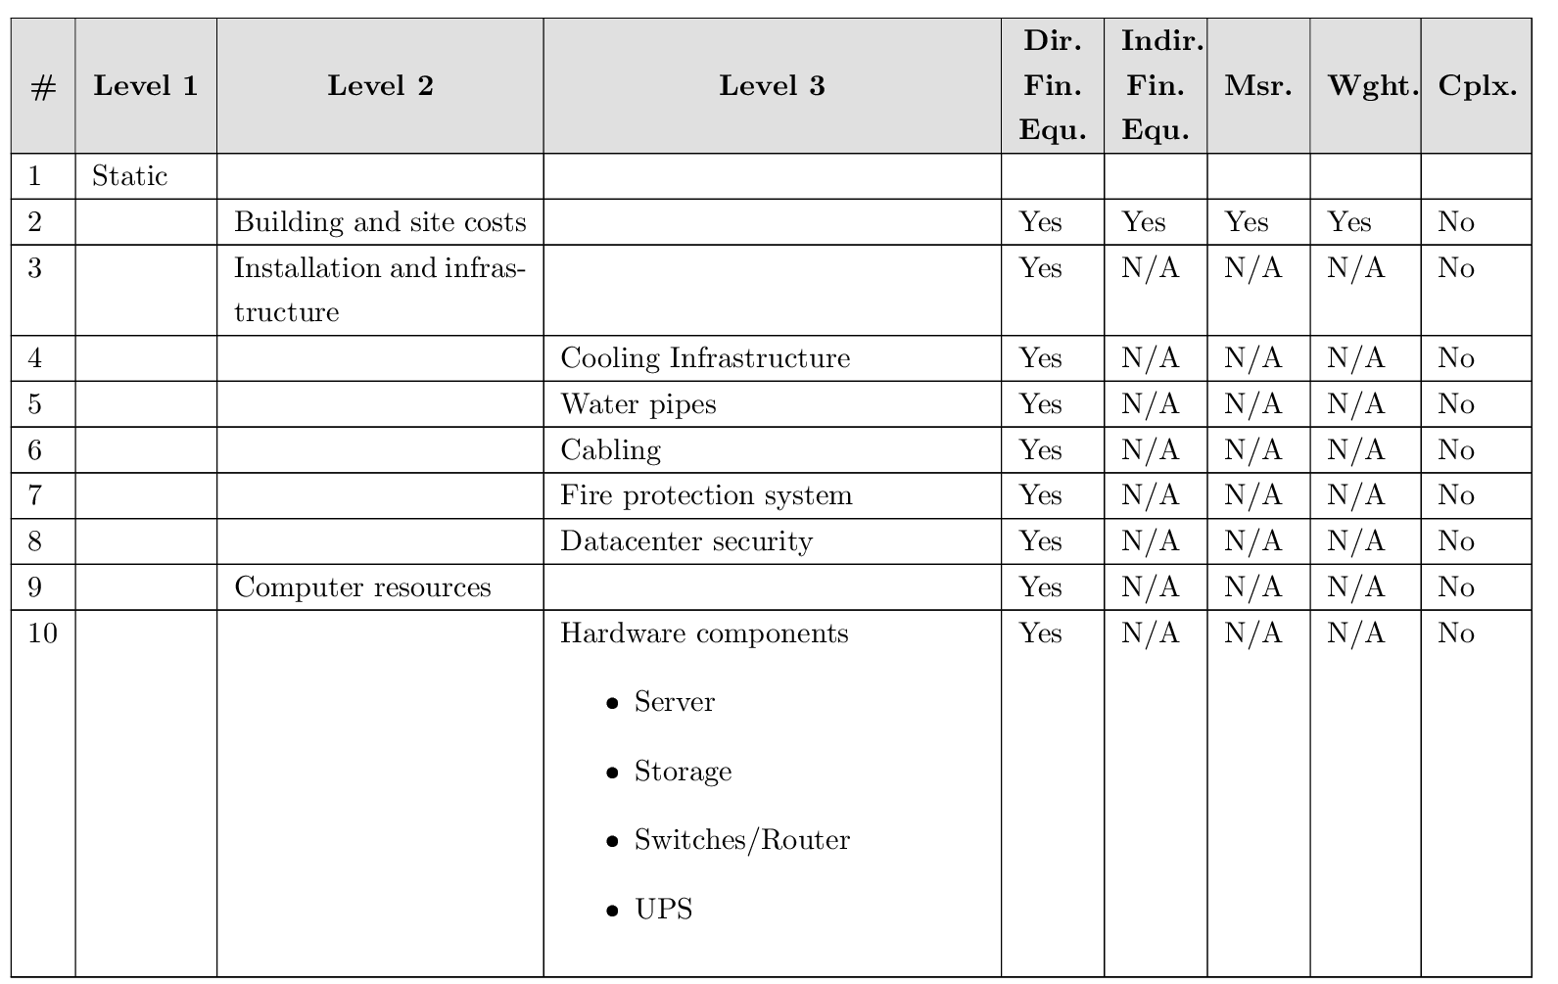
Pricing Factors Taxonomy in Details

Slide 65
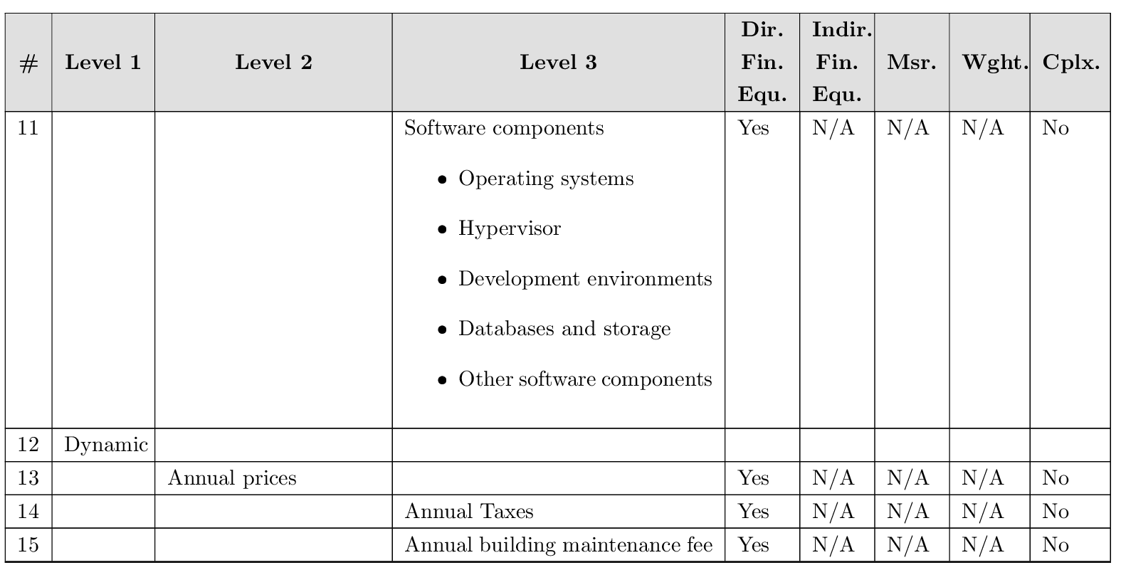
Pricing Factors Taxonomy in Details

Slide 66
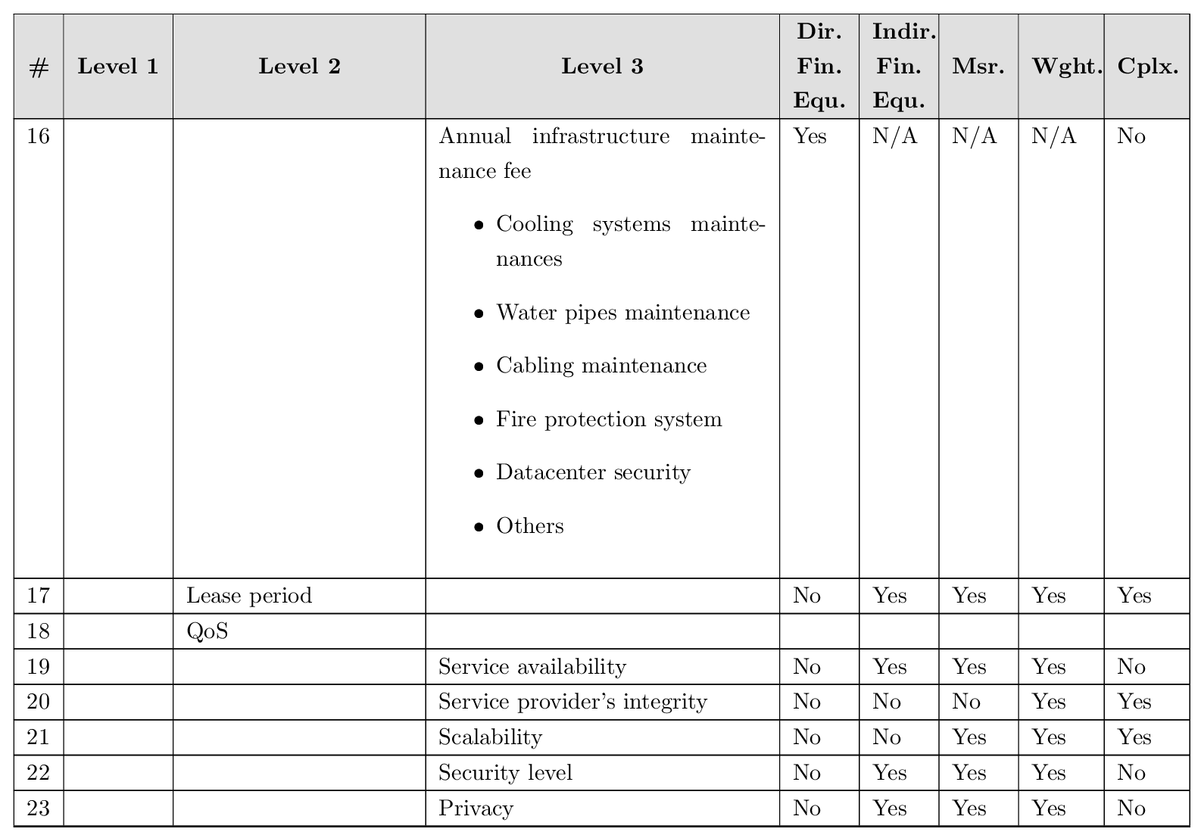
Pricing Factors Taxonomy in Details

Slide 67
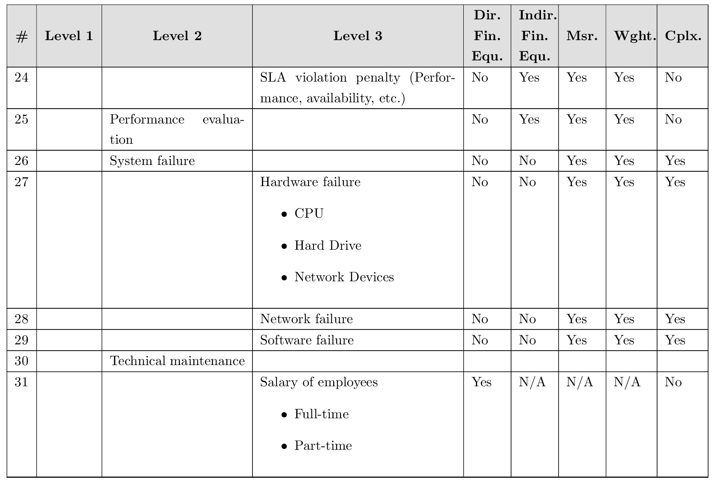
Pricing Factors Taxonomy in Details

Slide 68
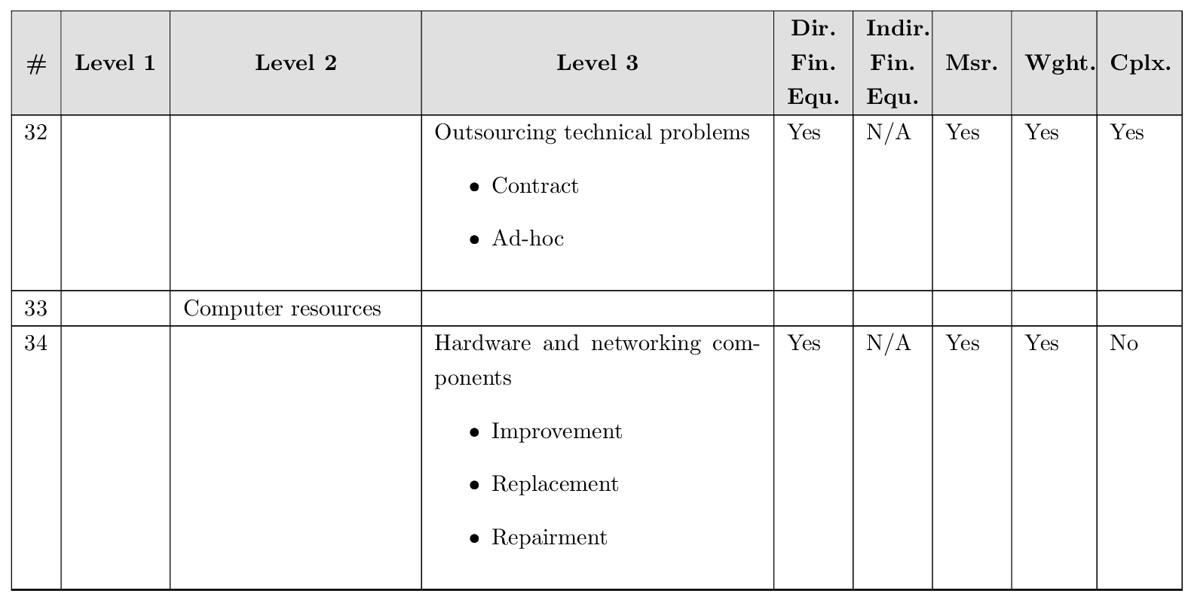
Pricing Factors Taxonomy in Details

Slide 69
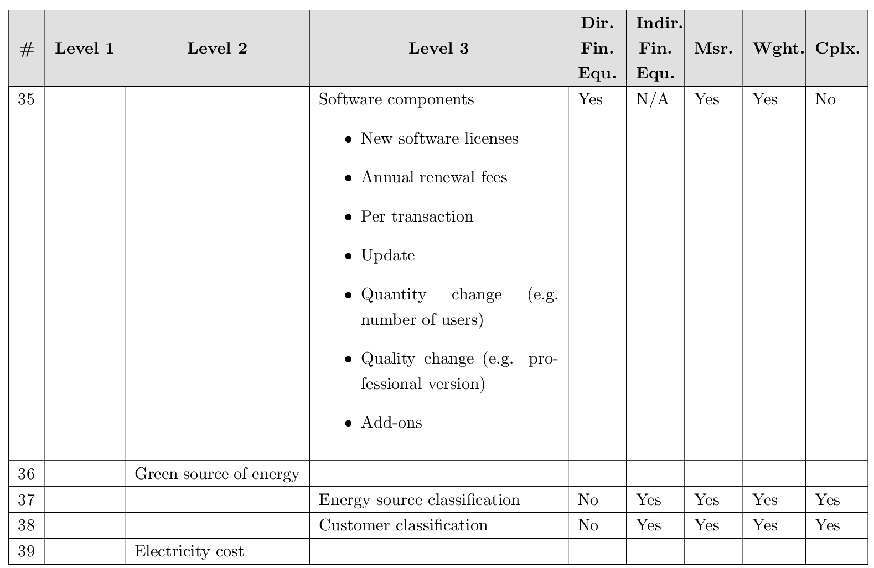
Pricing Factors Taxonomy in Details

Slide 70
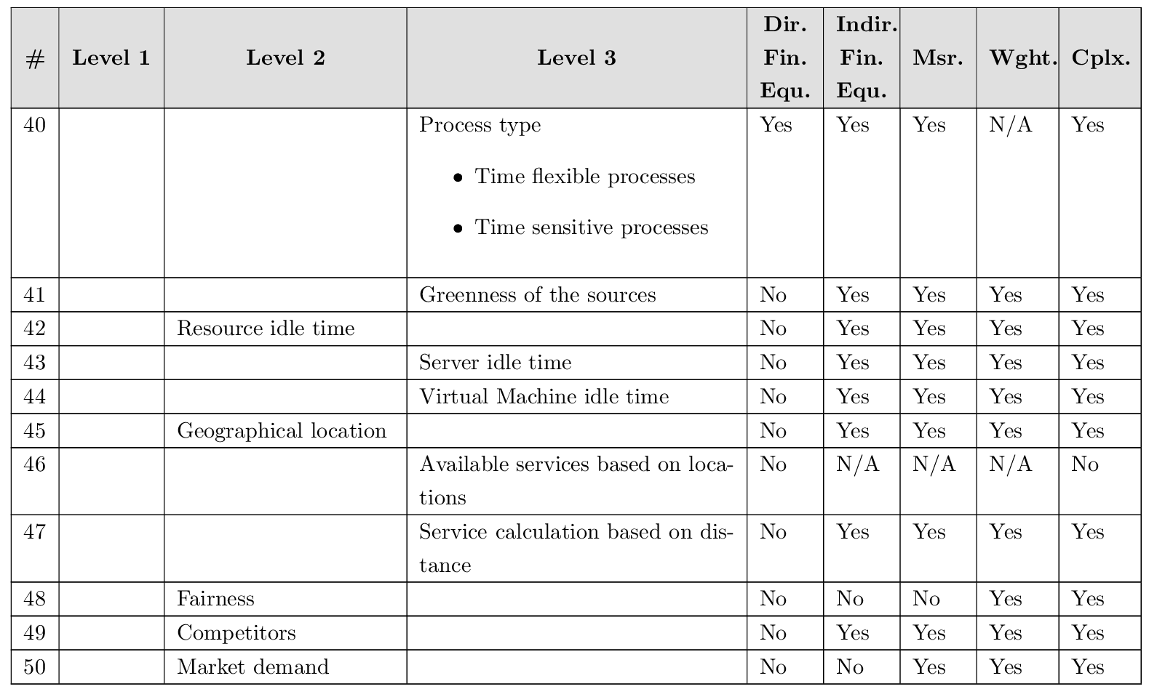
Pricing Factors Taxonomy in Details

